Slide 1
Rotor Hub & Pitch Control Team
Rahul Patil
Mostafa Mozafary
Islam Mohamed
Monitored By:
Ing. Christian Bulligk

Slide 2
Agenda
Rotor hub concept
Pitch system concept
Pitch bearing concept
Standards for pitch systems
Search for the used size and Suppliers in the Indian market

Slide 3
Rotor hub concept
Transfers Mechanical Energy:
Connects rotor blades to the main shaft
Transmits mechanical energy from blade rotation to the drivetrain
Supports Blade Pitch Control:
Houses mechanisms to adjust blade angles for optimal performance
Allows pitch control for energy capture and turbine regulation
Absorbs Loads and Stresses:
Handles aerodynamic and mechanical loads from the blades
Ensures even distribution of stress to the drivetrain

Slide 4
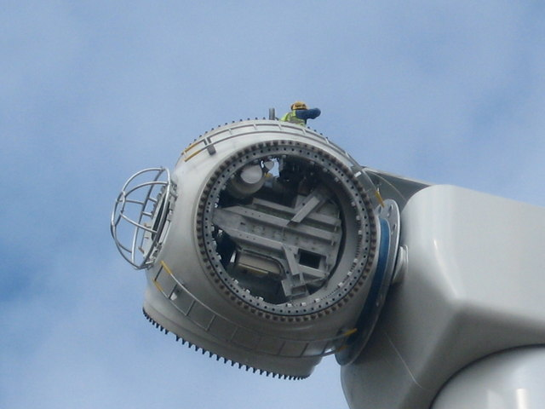
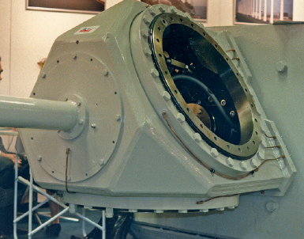
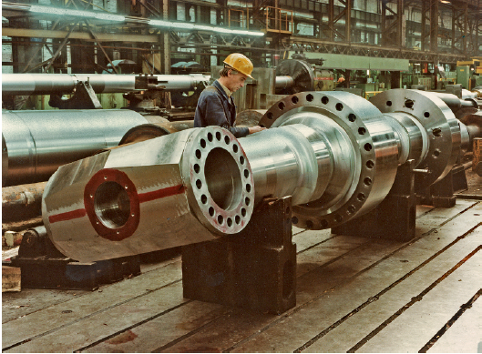
Casting | Welding and Fabrication | Forging
Casted in one piece: reducing stress concentrations Cost-effective: producing large volumes Design Flexibility: Can create complex shapes[3 ] | Customization Flexibility Lower initial investment compared to casting[3 ] | High Strength and Durability High fatigue resistance
High Initial Investment: The tooling cost for molds Post-Processing: Requires machining and heat treatment | Welded joints create stress concentrations Require High-quality control effort on welds | Limited Design Complexity Longer Lead Times High Cost for Large Parts
Fig 1: Casted Hub [1]
Fig 2: Welded Hub [2]
Fig 3: Forged Hub [2]
Tab. 1 Advantages and disadvantages of Casting, Welding, and Forging Hubs

Slide 5
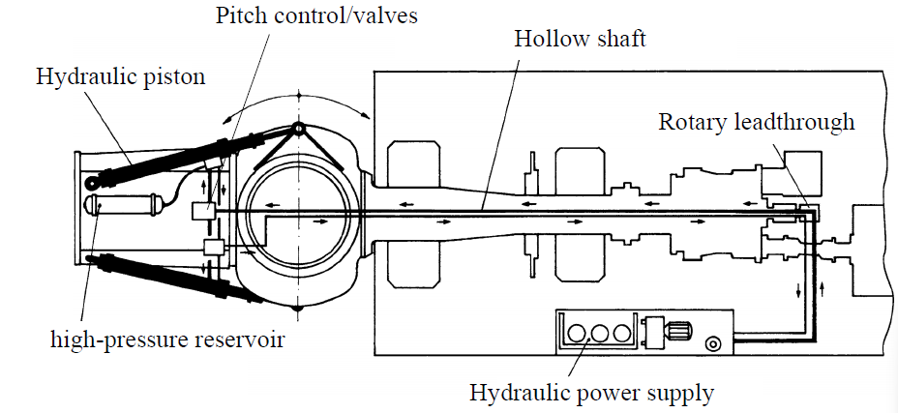
Pitch system
Hydraulic Pitch
Hydraulic fluid to adjust the angle of the rotor blades.
Hydraulic actuators controlled by a pitch controller regulate blade positioning via fluid pressure.
Power Supply: Hydraulic power unit provides constant pressure to the system.
Fig 3: Hydraulic Pitch System
Fig 4: Hydraulic Pitch Circuit [4]

Slide 6
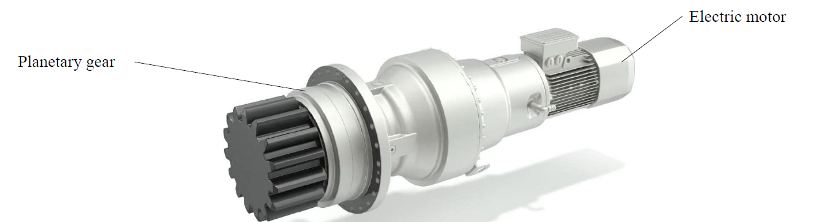
Pitch system
Electrical Pitch
Electric motors to control the pitch angle of the rotor blades.
Motors are connected directly to the rotor blade via gearboxes
Power Supply: Supplied by an electrical power source
Fig 5: Electrical Pitch Circuit
Fig 6: Pitch drive

Slide 7
Hydraulic Pitch System | Electrical Pitch System
+ Large power output with small components + High reliability + Lower number of components | + Individual system for each blade possible + High precision + Extended control possibilities
-High maintenance effort -Risk of leakage | -High transmission ratio – complicated gears needed -Higher costs for the gear and motor
Tab. 2 Advantages and disadvantages of Hydraulic, Electrical Pitch Systems

Slide 8
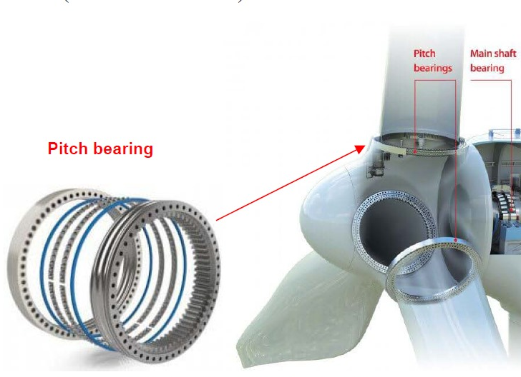
Pitch bearing
Pitch bearings in wind turbines, also known as blade bearings
Critical for handling high bending moments.
Operate efficiently even when stationary or rotating at low speeds.
Types of Pitch Bearings
Fig 7: Pitch bearing
Four-Point Contact Ball Bearing | Eight-Point Contact Ball Bearing
+ Simple and Cost-Effective design. [5] + Handles axial and radial loads well. + Reliable in traditional turbine setups. | + Reduces ball loads and stresses, increasing lifespan. + Better load distribution with two rows of balls. + Durable for large turbines.
-Lower performance in extreme conditions -Lower performance in extreme conditions | -More expensive to manufacture. -Complex assembly due to precise clearance.
Tab. 3 Advantages and disadvantages of Four-Point and Eight-Point Contact Ball Bearing

Slide 9
Relevant standards and guidelines:
Assessment documents
For the components specifications and assembly drawings shall be submitted
Assembly and sectional drawings (associated parts lists and if applicable individual , part drawings, description explaining the functional principle of the blade pitching system.)
The calculations for the verification of the components of the blade pitching system shall be presented.
Evaluation of Pitch Teeth: Required Drawings for Pitch Gearbox Systems (Pitch Pinion, Pinion shaft, blade bearing teeth)
The analysis of: the pitch gearbox teeth, the blade bearing teeth, the blade bearing teeth, load capacity considering the fatigue loads, static strength against tooth breakage and pitting, Fatigue strength and static strength for the output shaft of the pitch gearbox and for the connecting elements of a pitch system
In the case of hydraulic actuator, dimensioned drawings with the maximum and minimum positions the positions in which the greatest loads act on the blade pitching mechanism.
fatigue strength analysis and static strength analysis for all loads.

Slide 10
Relevant standards and guidelines:
Loads to be applied
The static and load-dependent bearing friction moments shall be taken into account.
Fatigue Analysis (Load Considerations)
Use Load Duration Distributions (LDD) or Load Spectra
Distinguish Between Operation With and Without Blade Pitching
Include Additional Inertial Loads from Rotor Rotation
Consider Dynamic Vibration-Exciting Loads
- Static Strength Analysis for Pitch Systems
Analyze With and Without Blade Pitching Operation
Use Design Loads from the Dimensioning Load Case
If Maximum Torque is Exceeded:
Consider Torque from Pitch Motor Brakes or Hydraulic Pressure
Use Maximum Torque Generated by the Pitch System for Analysis

Slide 11
Relevant standards and guidelines:
Loads to be applied
Blade Bearing Teeth Stress Analysis
Teeth are Stressed on a Small Part of Their Circumference
Maximum Rotation Angle Between Start and Stop: ~90°
Load Cycles for Gear Calculation:
Determine Appropriately
Multiply by Factor Based on Sector of Teeth Used
- Rotary Drive Systems: Strength Analysis
Use Application Factor: KA = 1.0
Applies to Static and Fatigue Strength Analysis

Slide 12
References
[1] Wikimedia. (2024, February 10). Pitch bearing. Wikipedia. https://en.wikipedia.org/wiki/Pitch_bearing#/media/File:Hub_secured_to_Turbine_Tower_No_11_-_geograph.org.uk_-_787507.jpg
[2] Hau, E. & Renouard, H. (2006). Mechanical Drive Train and Nacelle. In: Wind Turbines. Springer, Berlin, Heidelberg
[3 ] Demurtas, G. (2021, November 1). Wind Turbine Hub Design: Which is best?. LinkedIn. https://www.linkedin.com/pulse/wind-turbine-hub-design-which-best-giorgio-demurtas/
[4] Hau, E. (2005) Wind Turbines: Fundamentals, Technologies, Applications, Economics. Springer Berlin/ Heidelberg
[ 5] T. Harris, J.H. Rumbarger, and C.P. Butterfield: NREL: Wind Turbine Design Guideline DG03: Yaw and Pitch Rolling Bearing Life, checked on 9/28/2024.

